Slide 1


Case Study – Insite Application
March 2015
This document is confidential and contains proprietary information, including trade secrets of CitiusTech. Neither the document nor any of the information contained in it may be reproduced or disclosed to any unauthorized person under any circumstances without the express written permission of CitiusTech.

Slide 2
Agenda
Architecture
Benefits & Alternate options
What & Why?

Slide 3
What & Why of the pattern?
Which Patterns?
Architectural Pattern
- Layered Architecture
Design Patterns
- MVC (Spring)
- Factory (Spring)
- AOP (Spring)
- Façade
- Domain Objects
- Data Access Objects - DAO
Why do you need the pattern?
Help avoid reinvention
Enable large scale reuse of software
Helps in improve developer communication
Captures expert knowledge and design trade-offs and make expertise widely available

Slide 4
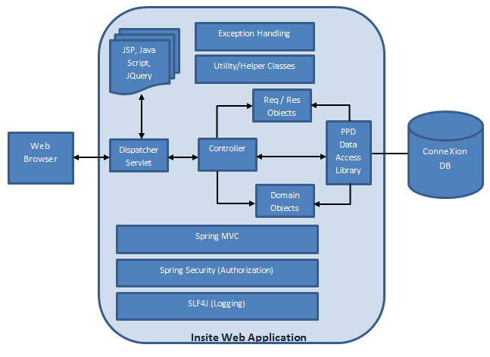
Architecture
Architecture Diagram of project
Description
PPD-Insite is a web based application to be accessed by a closed group of external and internal users from across the world
It will be deployed on Apache Tomcat webserver
It will sit behind Firewalls and Single Sign-on mechanism within PPD data centre
It uses Bootstrap library extensively and makes use of JQuery and JSON to provide an enriched user experience
It connects to PPD’s central DB - ConneXion

Slide 5
Benefits & Alternate Options
Benefits & Drawbacks of the pattern
Layered architecture allows segregation of responsibility between application and database
MVC and Façade allows extensibility to build new interfaces to use same business services
Factory and AOP allows easy pluggability of a different flavour of implementation
Domain Objects allows neat segregation of domain entity data from request/response data
DAO allows code by interface and specialised and pluggable implementation
Typical Healthcare use cases
All web applications, none specific to healthcare
Alternate Options (if any)
Using EJBs – Would have been overkill and the client architect preferred simplicity over enterprise level container services

Slide 6
Thank You

